Slide 1
Mathematical Foundations for ML (10-606):
Singular values and low-rank matrices
Bryan Wilder

Slide 2
Announcements

Slide 3
Today
Singular value decomposition
Low-rank decompositions
Application to matrix factorization

Slide 4
Warmup: eigendecomposition

Slide 5
Singular Value Decomposition
So far, we have talked about a lot of concepts that are only defined for square matrices, like inverses, eigenvectors, and eigenvalues.
Do these concepts have generalizations for non-square matrices?
Yes!

Slide 6
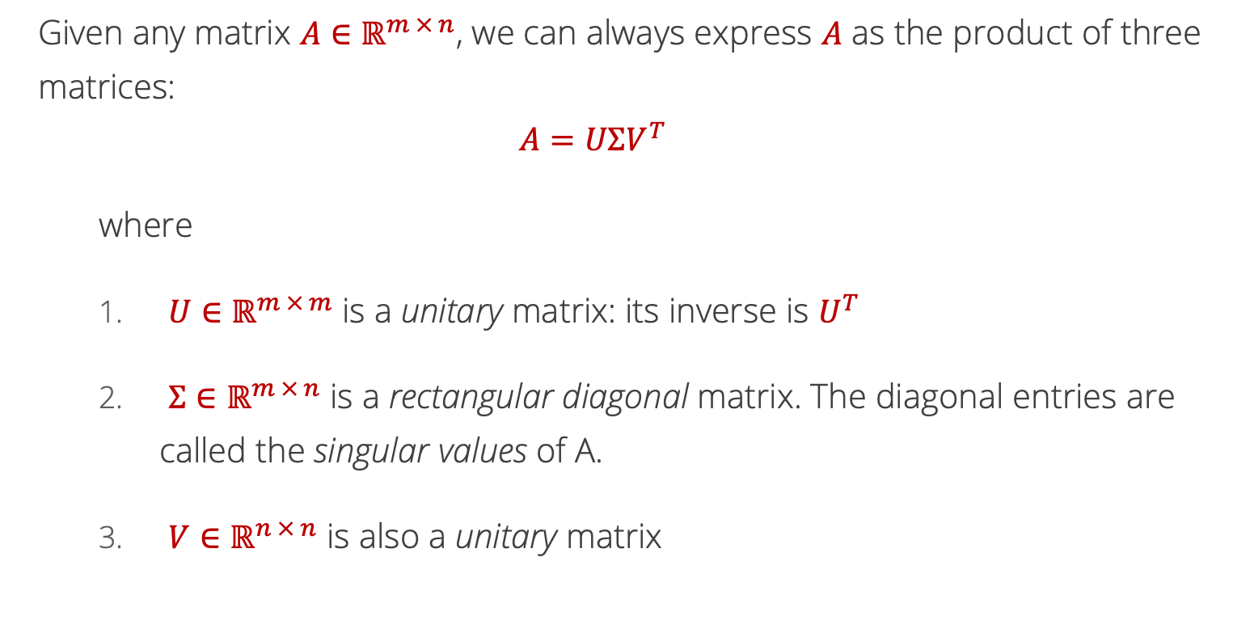
Singular Value Decomposition
Given any matrix $A∈ℝ^{m × n}$, we can always express $A$ as the product of three matrices:
$$A=UΣV^{T}$$
where
$U∈ℝ^{m × m}$ is a unitary matrix: its inverse is $U^{T}$
${Σ∈ℝ}^{m × n}$ is a rectangular diagonal matrix. The diagonal entries are called the singular values of A.
$V∈ℝ^{n × n}$ is also a unitary matrix

Slide 7
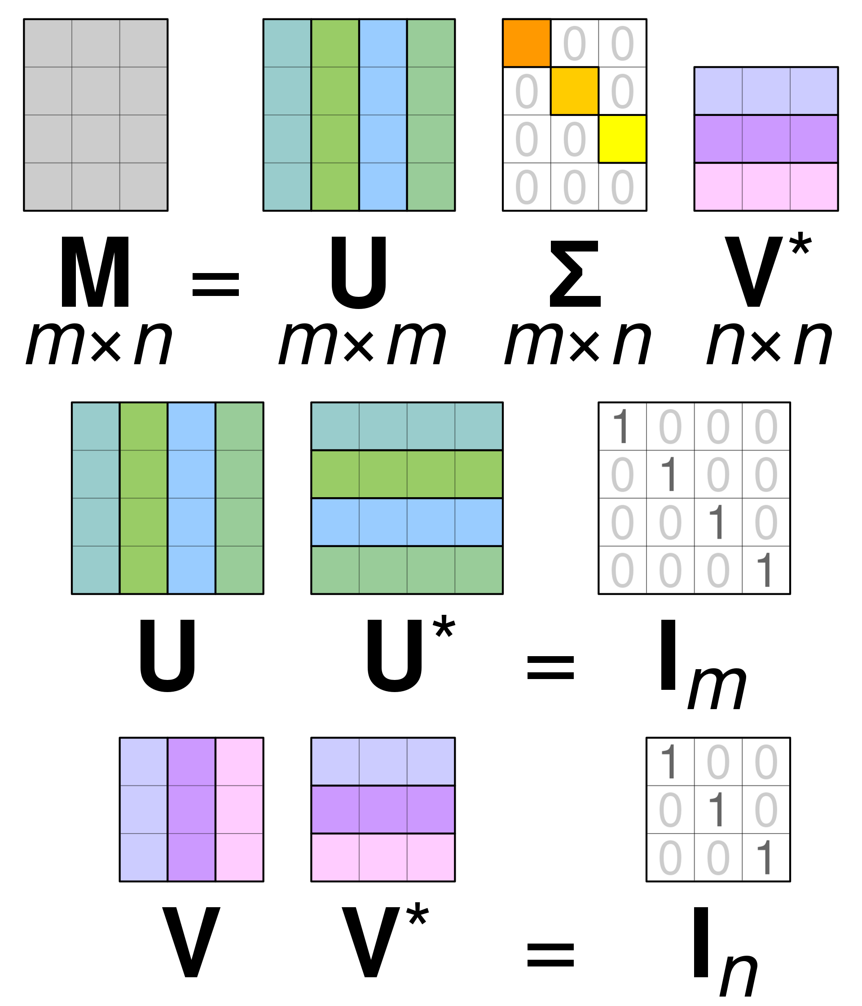
Singular Value Decomposition Pictorially
T
A
T
T
Source: https://en.wikipedia.org/wiki/Singular_value_decomposition#/media/File:Singular_value_decomposition_visualisation.svg

Slide 8
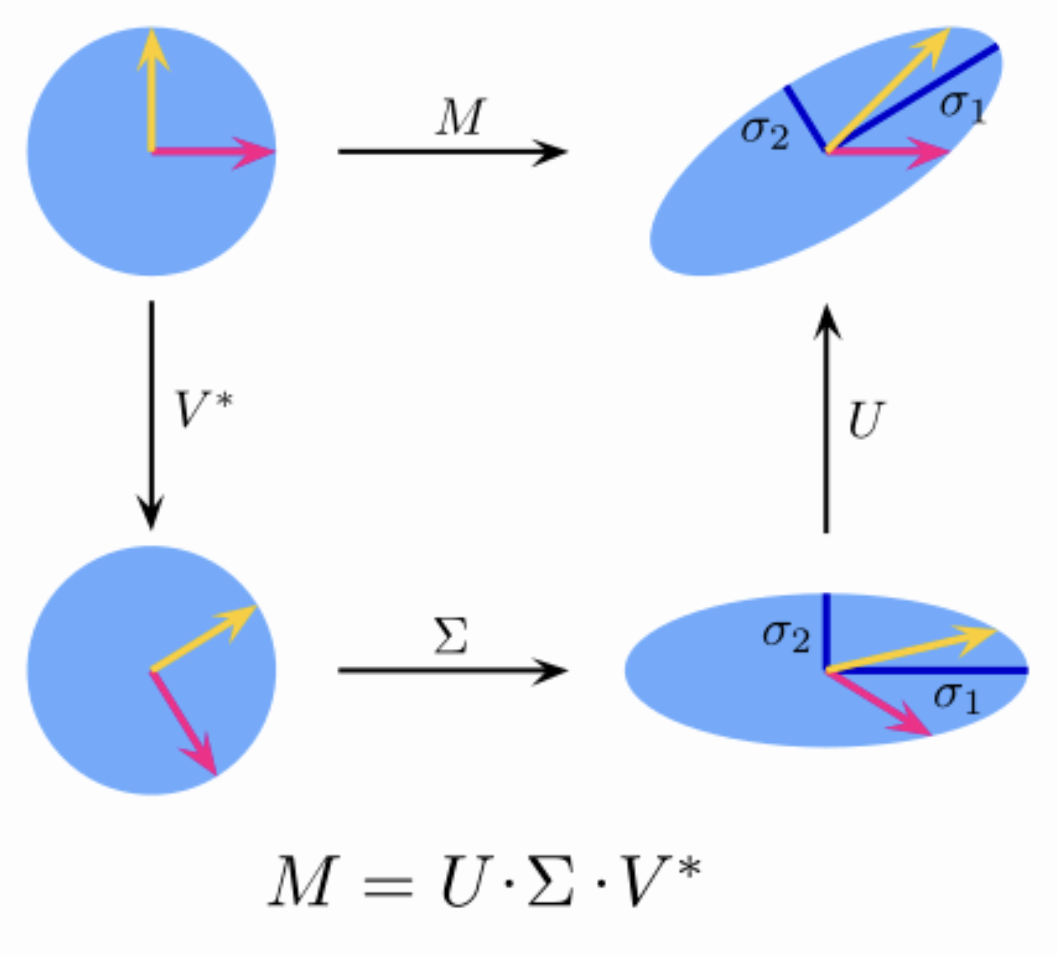
T
T

Slide 9
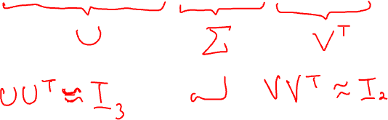
Singular Value Decomposition Example
$$A=\left[\begin{matrix}3 & 1 \\ −1 & 0 \\ 2 & −2\end{matrix}\right]≈\left[\begin{matrix}−0.765 & −0.598 & −0.241 \\ −0.265 & −0.049 & −0.963 \\ −0.588 & −0.800 & −0.120\end{matrix}\right]\left[\begin{matrix}3.756 & 0 \\ 0 & 2.211 \\ 0 & 0\end{matrix}\right]\left[\begin{matrix}−0.994 & 0.109 \\ −0.109 & 0.994\end{matrix}\right]$$

Slide 10
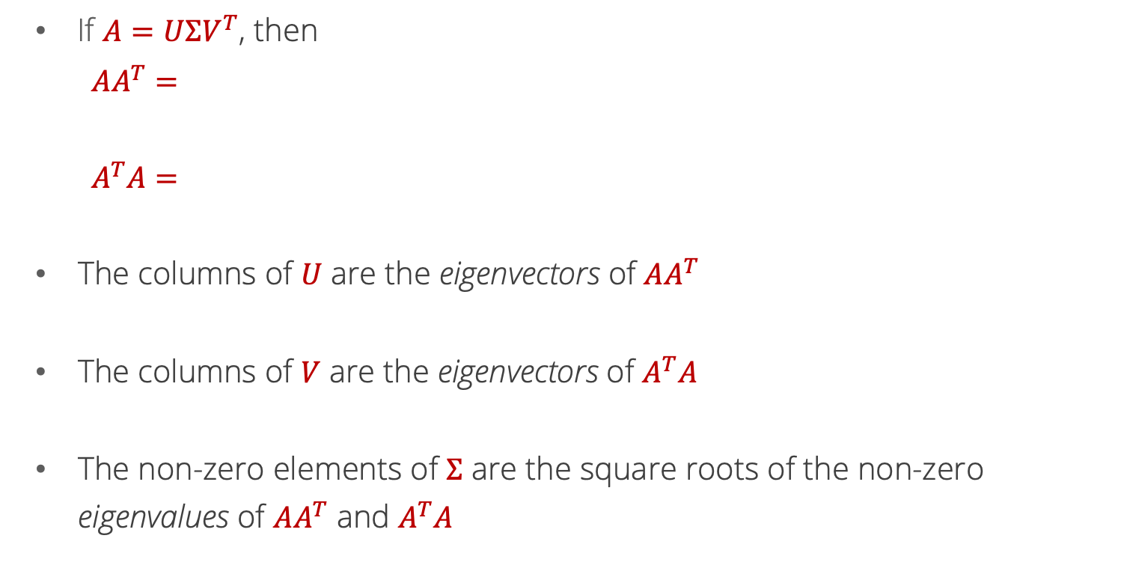
Singular Value Decomposition Interpretation
If $A=UΣV^{T}$, then
$$AA^{T}=$$
$$A^{T}A=$$
The columns of $U$ are the eigenvectors of $AA^{T}$
The columns of $V$ are the eigenvectors of $A^{T}A$
The non-zero elements of $Σ$ are the square roots of the non-zero eigenvalues of $AA^{T}$ and $A^{T}A$

Slide 11
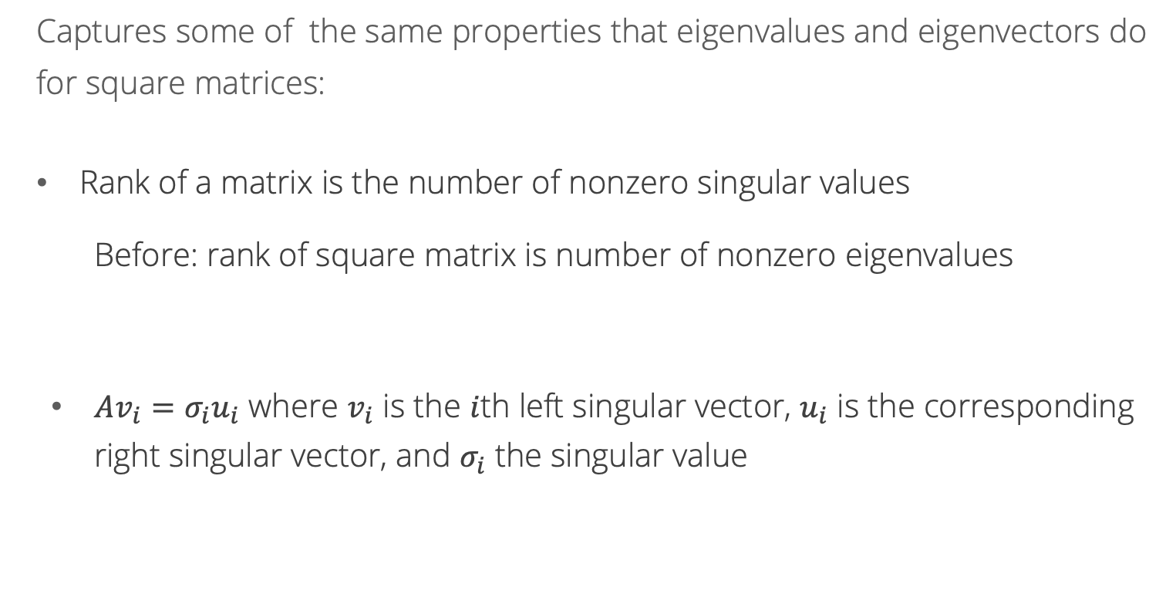
Singular Value Decomposition Interpretation
Captures some of the same properties that eigenvalues and eigenvectors do for square matrices:
Rank of a matrix is the number of nonzero singular values
Before: rank of square matrix is number of nonzero eigenvalues
$Av_{i}=σ_{i}u_{i}$ where $v_{i}$ is the $i$th left singular vector, $u_{i}$ is the corresponding right singular vector, and $σ_{i}$ the singular value

Slide 12
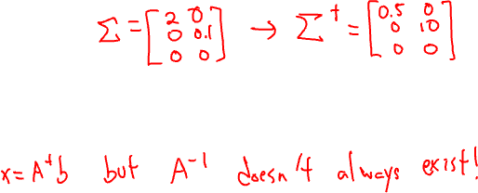
Singular Value Decomposition Uses
If $A=UΣV^{T}$, then the pseudoinverse of a $A$ is
$$A^{†}=VΣ^{†}U^{T}$$
where $Σ^{†}$ is created by replacing every non-zero entry in $Σ$ with its reciprocal, e.g.,
$${Σ= \left[\begin{matrix}2 & 0 \\ 0 & 0.1\end{matrix}\right]→Σ}^{†}=\left[\begin{matrix}0.5 & 0 \\ 0 & 10\end{matrix}\right]$$
The pseudoinverse of a matrix can be used to solve problems of the form $Ax=b$ when $A$ is singular i.e., when the inverse of $A$ does not exist!

Slide 13
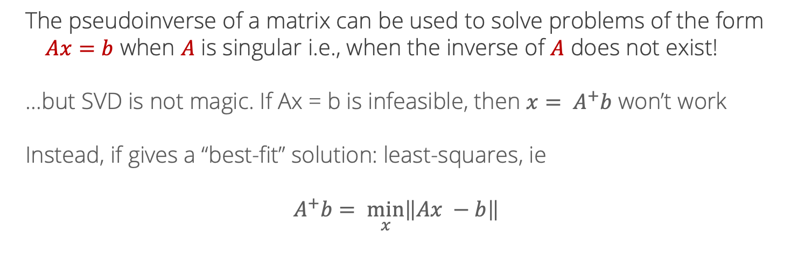
Pseudo-inverse
The pseudoinverse of a matrix can be used to solve problems of the form $Ax=b$ when $A$ is singular i.e., when the inverse of $A$ does not exist!
…but SVD is not magic. If Ax = b is infeasible, then ${x= A}^{+}b$ won’t work
Instead, if gives a “best-fit” solution: least-squares, ie
$$A^{+}b= \min_{x}\left\|Ax −b\right\|$$

Slide 14
Low-rank matrices
So far, focused on nice properties of full-rank matrices:
Inverses
Unique solutions of linear systems
But a lot of the time in machine learning, we hope that matrices aren’t fully rank!
Recall: recommendation systems

Slide 15
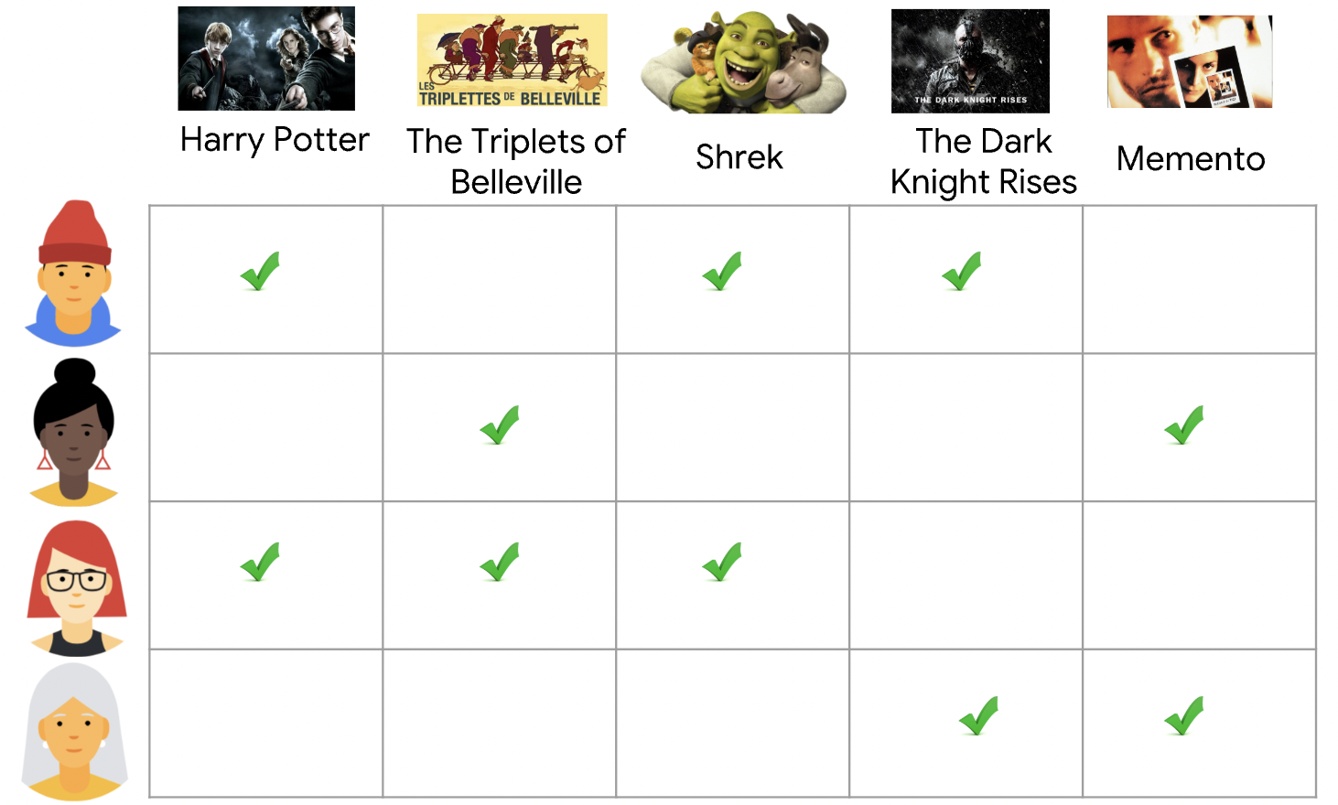
Why Math for ML (10-606)? Recommendation systems
https://developers.google.com/machine-learning/recommendation/collaborative/basics

Slide 16
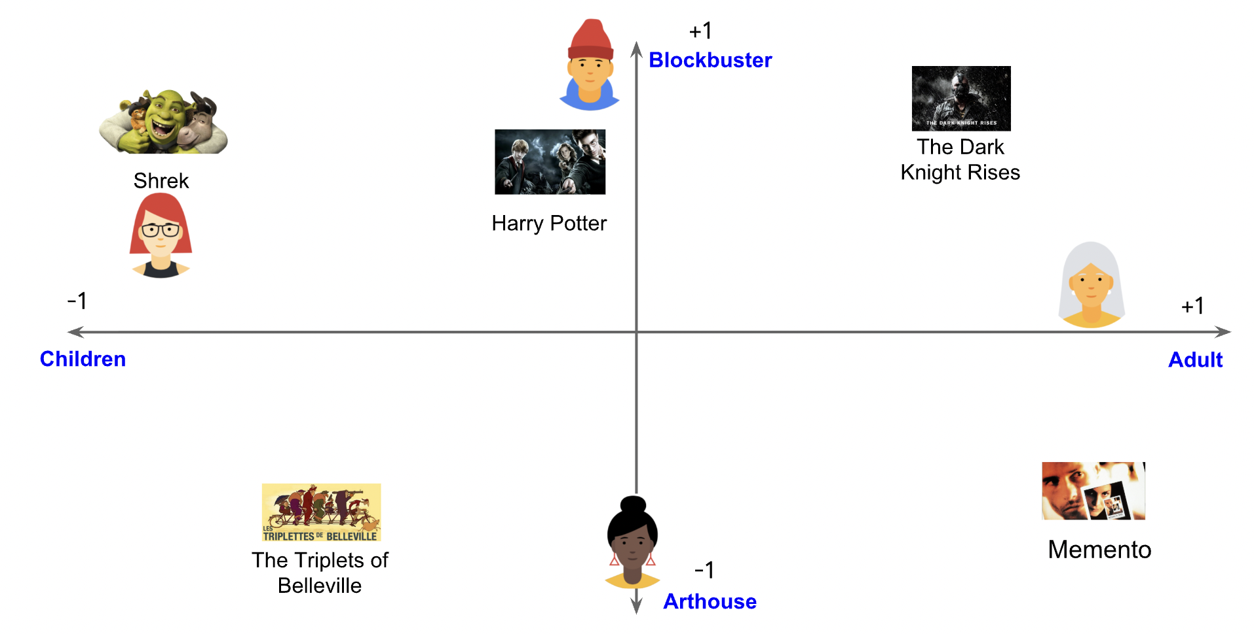
Why Math for ML (10-606)? Recommendation systems

Slide 17
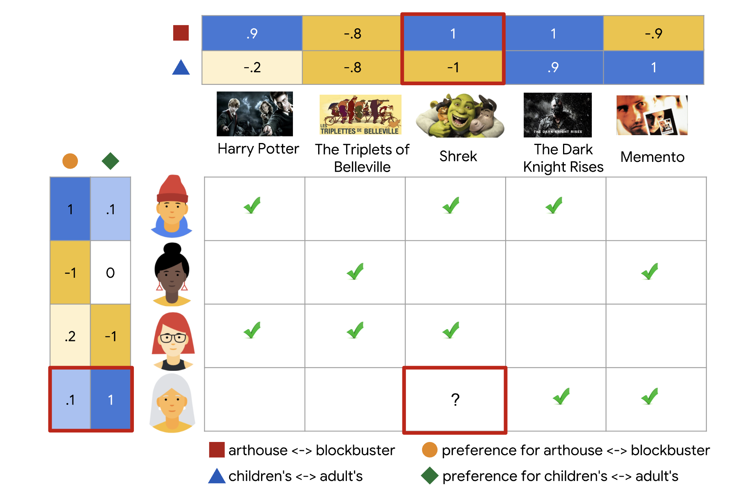
Why Math for ML (10-606)? Recommendation systems
Today: show that
(1) This structure corresponds to a low-rank ratings matrix.
(2) The singular value decomposition can be used to find the best low-rank approximation of a matrix.
1+2 = recommendation systems

Slide 18
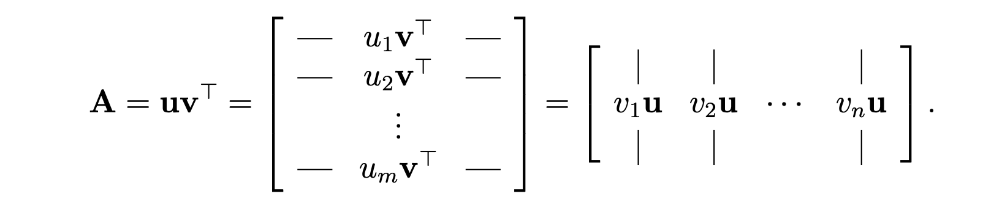
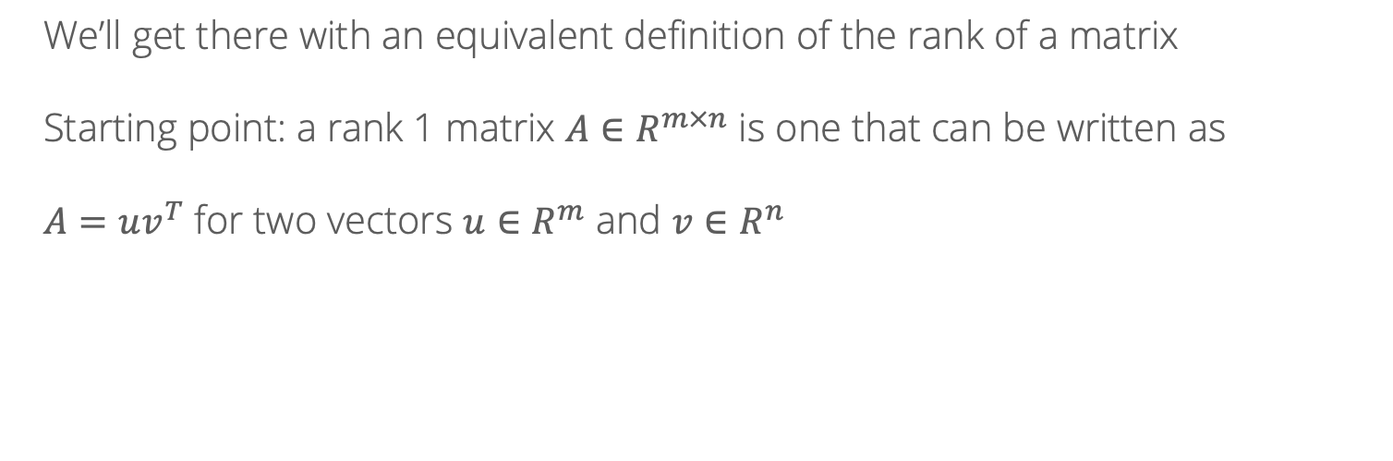
Low-rank matrices
We’ll get there with an equivalent definition of the rank of a matrix
Starting point: a rank 1 matrix $A∈R^{m×n}$ is one that can be written as
$A=uv^{T}$ for two vectors $u∈R^{m}$ and $v∈R^{n}$
Image: https://web.stanford.edu/class/cs168/l/l9.pdf

Slide 19
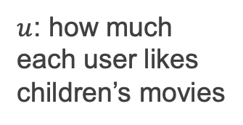
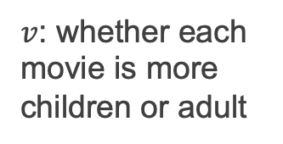
Low-rank matrices
$u$: how much each user likes children’s movies
$v$: whether each movie is more children or adult
$A_{ij}=$ rating of user $i$ for movie $j$ = $u_{i}v_{j}$

Slide 20
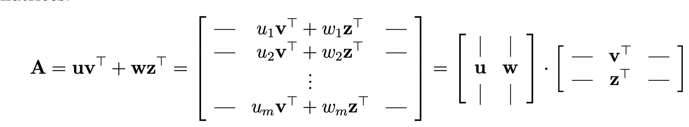
Low-rank matrices
A rank 2 matrix is just the sum of two rank-1 matrices
Children vs adult
Adult vs blockbuster
User characteristics
Item characteristics

Slide 21
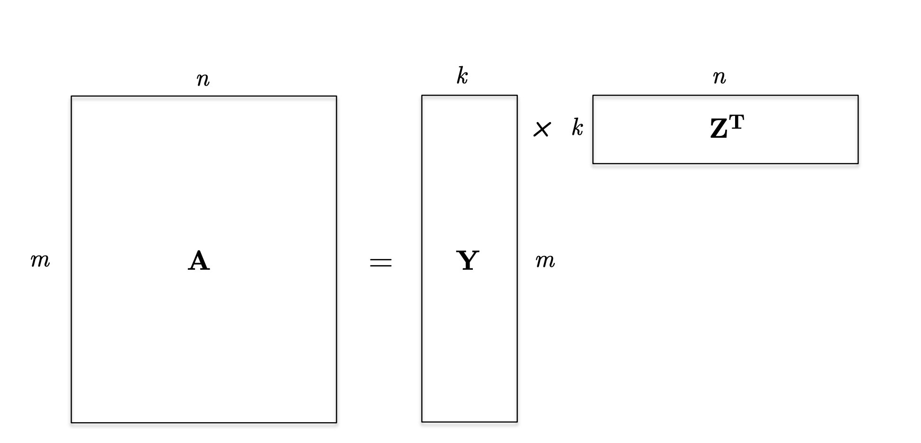
Low-rank matrices
A rank $k$ matrix is the sum of $k$ rank-one matrices, or equivalently the product of a $m×k$ matrix and a $k×n$ matrix!

Slide 22
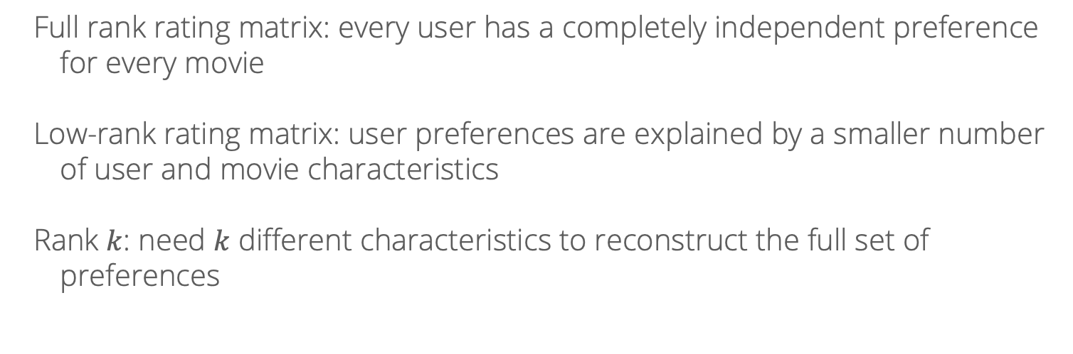
Low-rank matrices
Full rank rating matrix: every user has a completely independent preference for every movie
Low-rank rating matrix: user preferences are explained by a smaller number of user and movie characteristics
Rank $k$: need $k$ different characteristics to reconstruct the full set of preferences

Slide 23
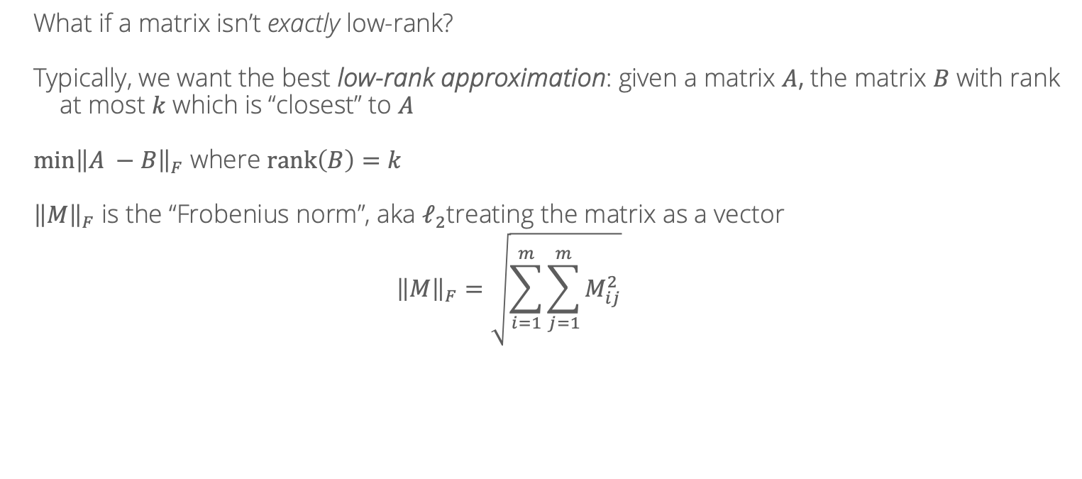
Low-rank matrices
What if a matrix isn’t exactly low-rank?
Typically, we want the best low-rank approximation: given a matrix $A$, the matrix $B$ with rank at most $k$ which is “closest” to $A$
$\min{{\left\|A −B\right\|}_{F}}$ where $rank\left(B\right)=k$
${\left\|M\right\|}_{F}$ is the “Frobenius norm”, aka $ℓ_{2}$treating the matrix as a vector
$${\left\|M\right\|}_{F}=\sqrt{\sum_{i=1}^{m}{\sum_{j=1}^{m}{M_{ij}^{2}}}}$$

Slide 24
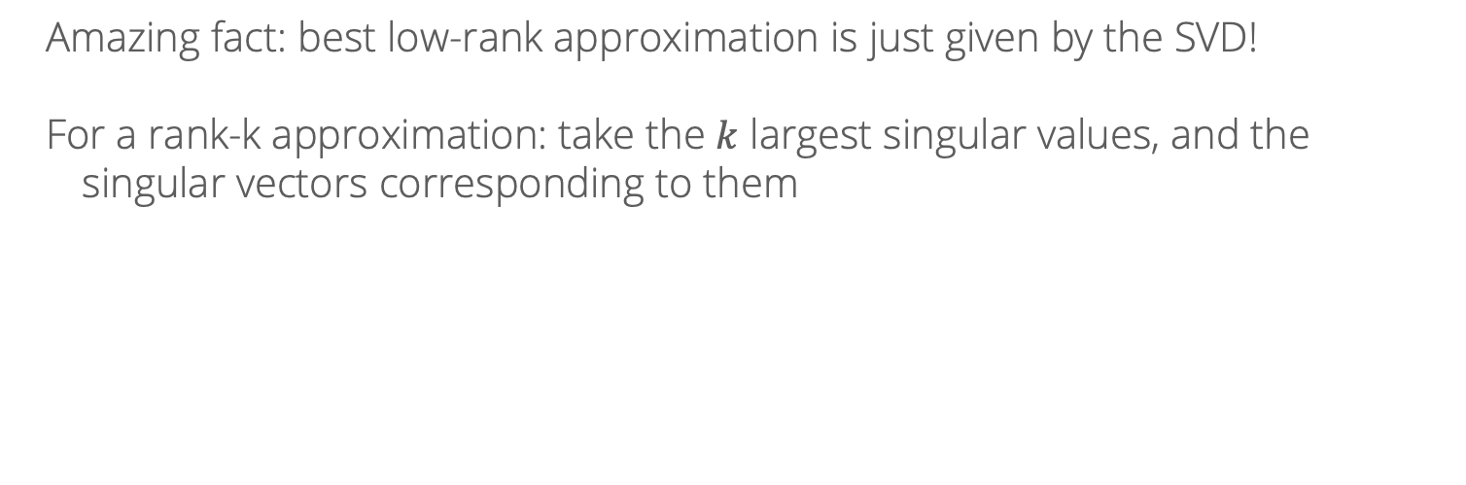
Low-rank matrices
Amazing fact: best low-rank approximation is just given by the SVD!
For a rank-k approximation: take the $k$ largest singular values, and the singular vectors corresponding to them

Slide 25
Singular Value Decomposition Pictorially
A
Source: https://en.wikipedia.org/wiki/Singular_value_decomposition#/media/File:Singular_value_decomposition_visualisation.svg

Slide 26
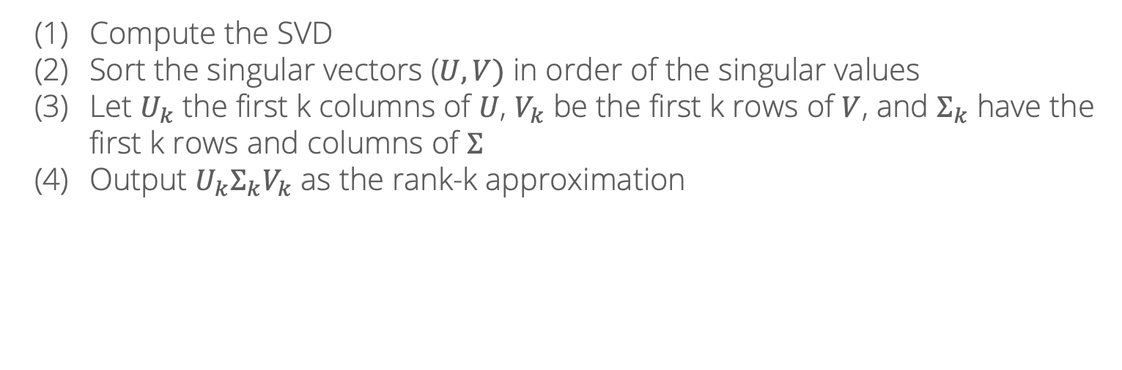
SVD algorithm for matrix completion
Compute the SVD
Sort the singular vectors ($U, V)$ in order of the singular values
Let $U_{k}$ the first k columns of $U$, $V_{k}$ be the first k rows of $V$, and $Σ_{k}$ have the first k rows and columns of $Σ$
Output $U_{k}Σ_{k}V_{k}$ as the rank-k approximation

Slide 27
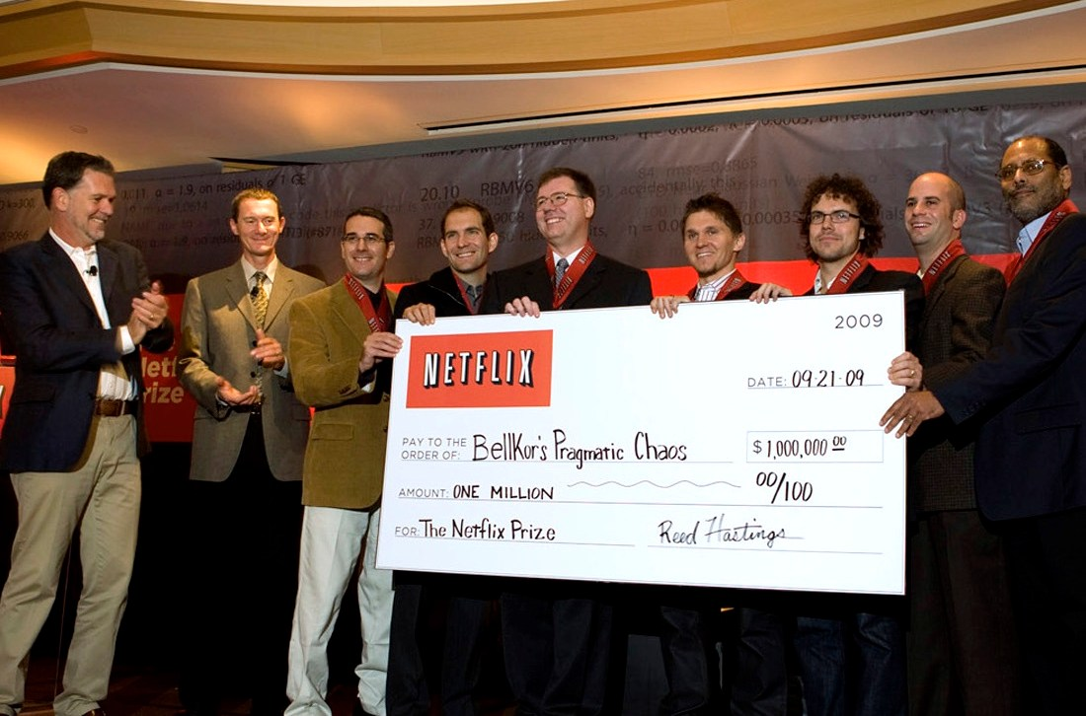
SVD algorithm for matrix completion
A bit of history: many of these ideas were developed/popularized in a competition Netflix ran, promising a $1 million prize to the team that improved their recommender system by at least 10%
The top solutions all used SVD/matrix factorization (plus other tricks), and similar ideas are widely used today
In another couple weeks: introduce the algorithms to run these methods at Netflix scale!

Slide 28
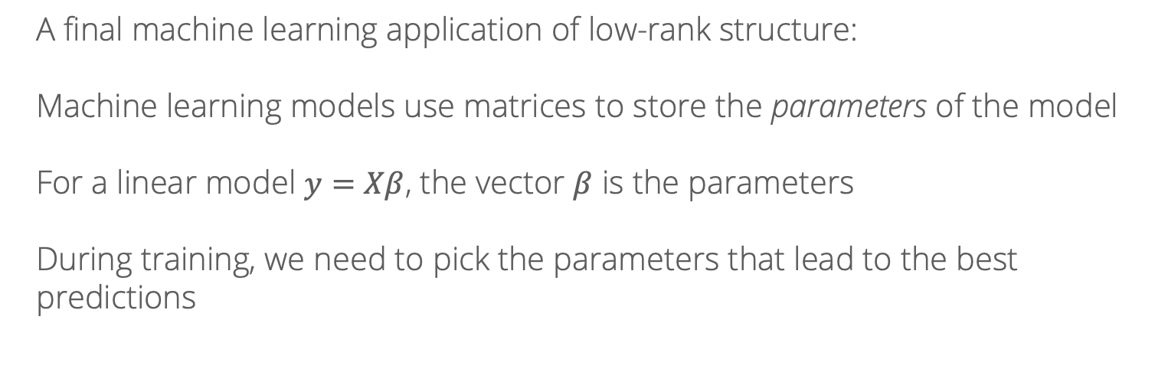
Low-rank updates
A final machine learning application of low-rank structure:
Machine learning models use matrices to store the parameters of the model
For a linear model $y=Xβ$, the vector $β$ is the parameters
During training, we need to pick the parameters that lead to the best predictions

Slide 29
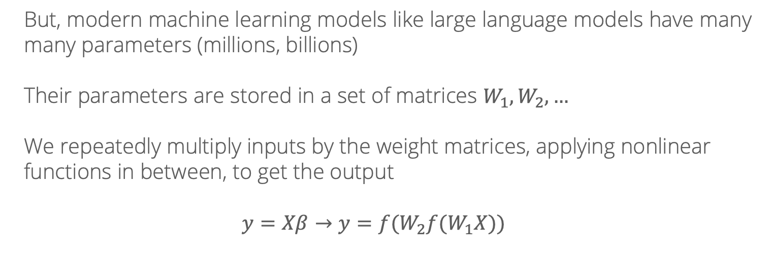
Low-rank updates
But, modern machine learning models like large language models have many many parameters (millions, billions)
Their parameters are stored in a set of matrices $W_{1}, W_{2},…$
We repeatedly multiply inputs by the weight matrices, applying nonlinear functions in between, to get the output
$$y=Xβ→y={f(W}_{2}f(W_{1}X))$$

Slide 30
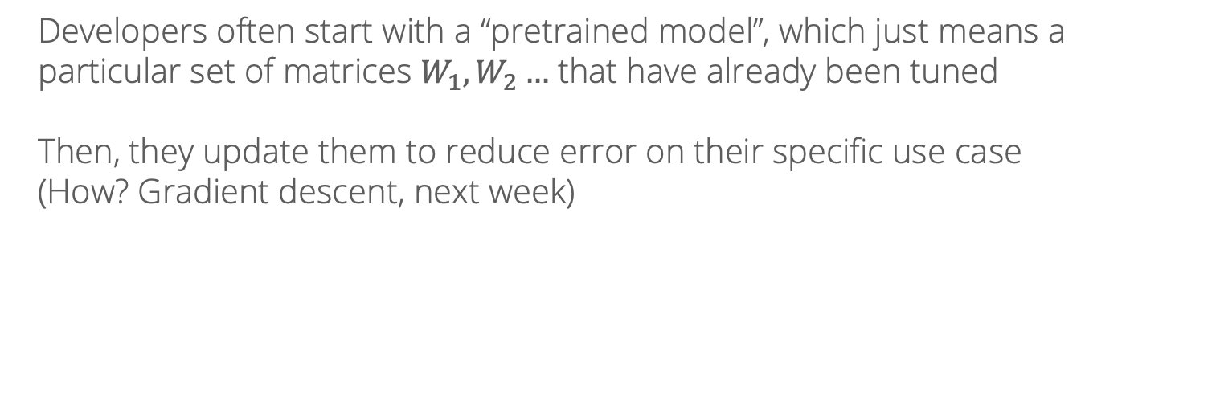
Low-rank updates
Developers often start with a “pretrained model”, which just means a particular set of matrices $W_{1}, W_{2}…$ that have already been tuned
Then, they update them to reduce error on their specific use case
(How? Gradient descent, next week)

Slide 31
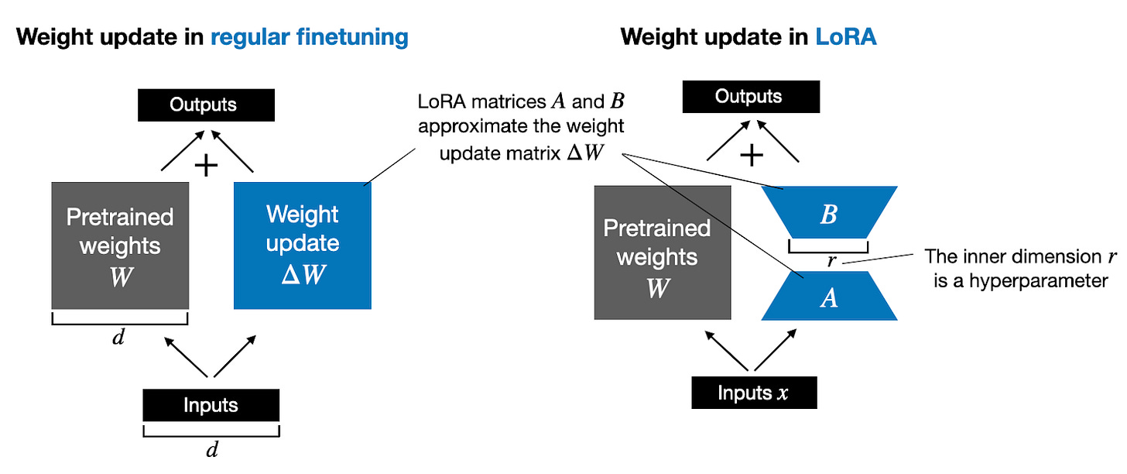
Low-rank updates
But, modifying those billions of parameters directly is super computationally expensive…
What if the updates to the parameters could be approximated as low rank?

Slide 32
Low-rank updates
This idea, called LoRA (Low Rank Adaptation) is now routinely used in finetuning LLMs and other large machine learning models!

